Slide 1
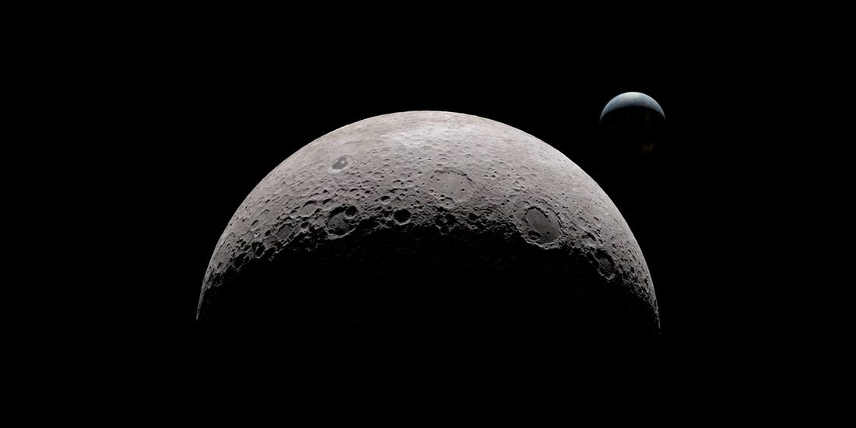
NASA Self-Leveling System
EML 4551
Team 516:
Stephen Brown
James Evans
Dalton LeClair
Jake Seaman
Parker Stensrud

Slide 2












Team Introductions
Stephen Brown
Materials Engineer
James Evans
Design Engineer
Dalton LeClair
Test
Engineer
Jake Seaman
Systems Engineer
Parker Stensrud
Controls Engineer
Stephen Brown

Slide 3
Team Introductions
Stephen Brown
Materials Engineer
James Evans
Design Engineer
Dalton LeClair
Test
Engineer
Jake Seaman
Systems Engineer
Parker Stensrud
Controls Engineer
Stephen Brown

Slide 4




Sponsor and Advisor
Project Sponsor
Rachel McCauley
NASA Marshall Space Flight Center
Faculty Advisor
Dr. Dorr Campbell
FAMU-FSU College of Engineering
Stephen Brown

Slide 5

Project Background
Stephen Brown

Slide 6

Project Scope
The objective of our project is to provide a level working environment for the astronauts aboard the lunar lander.
Stephen Brown

Slide 7






Stephen Brown

Slide 8

Project Goals
Level Within an Hour
Leveling Capabilities up to 12-Degree Slope
Reusability
Supports 14-16 Metric Tons
Stephen Brown

Slide 9

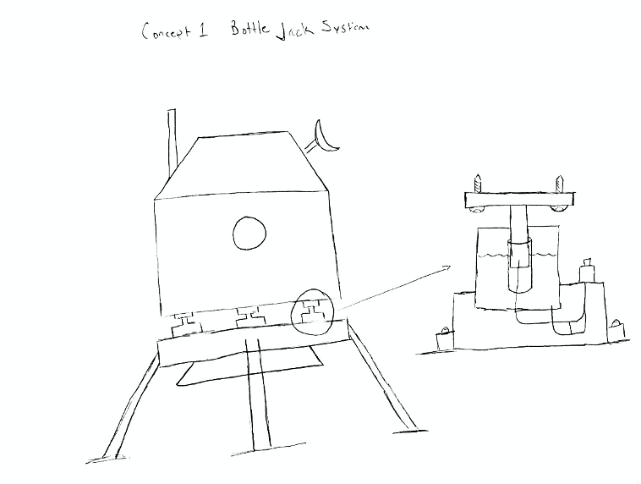

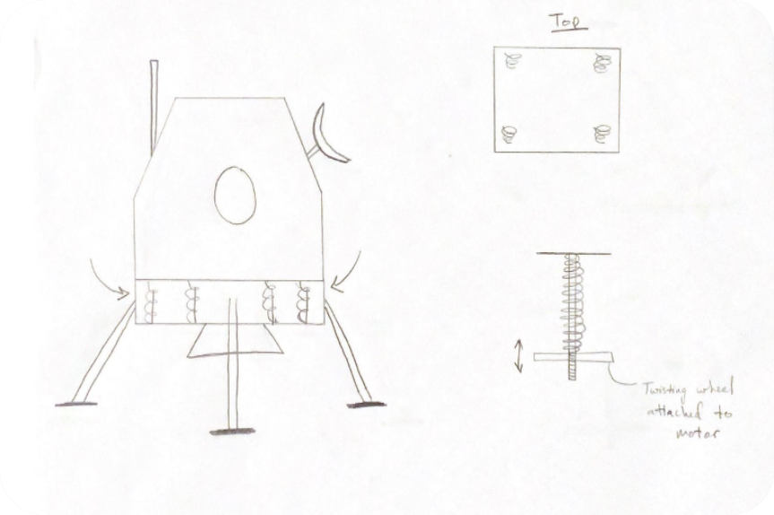
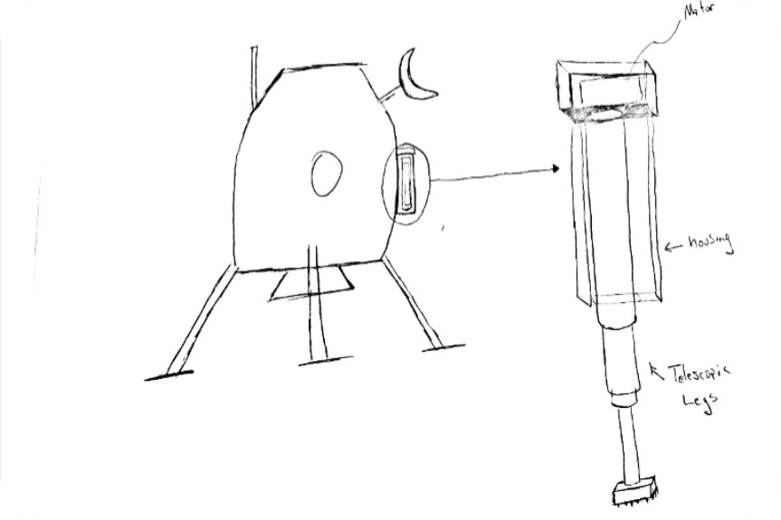

Concept Generation
Brainstormed 100 concepts
  Used biomimicry, crapshoot, and a morphological chart
Narrowed concepts down into 5 medium fidelity and 3 high fidelity
Stephen Brown

Slide 10
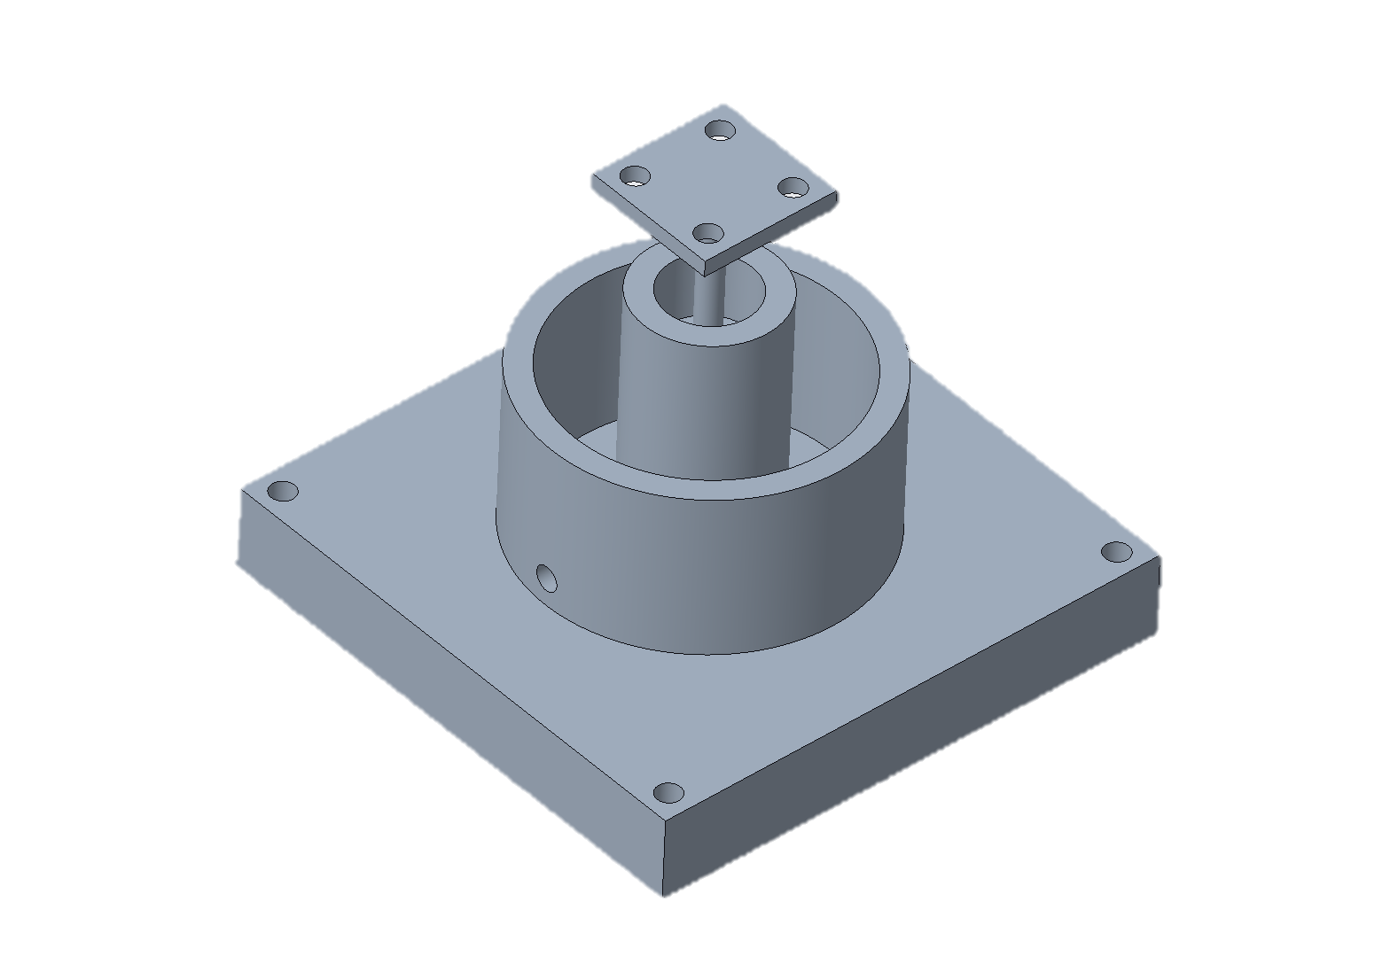
Concept Selection
Processed medium and high-fidelity concepts using various concept selection tools
  House of Quality, Pugh Matrix, Analytical Hierarchy Process
Bottle Jack system received highest rank
Stephen Brown

Slide 11


Prototype Breakdown
Stephen Brown

Slide 12
Prototype Scaling
Apollo Lander Specs
Weight | 14-16 tons
Dimensions/footprint | 31’ x 20’
Time to level | 1 hour
Cost | $21.3 Billion
Scaled Prototype Specs
Weight | 60 lbs
Dimensions/footprint | 50” x 31”
Time to level | 10 minutes
Cost | $853.56
Stephen Brown

Slide 13
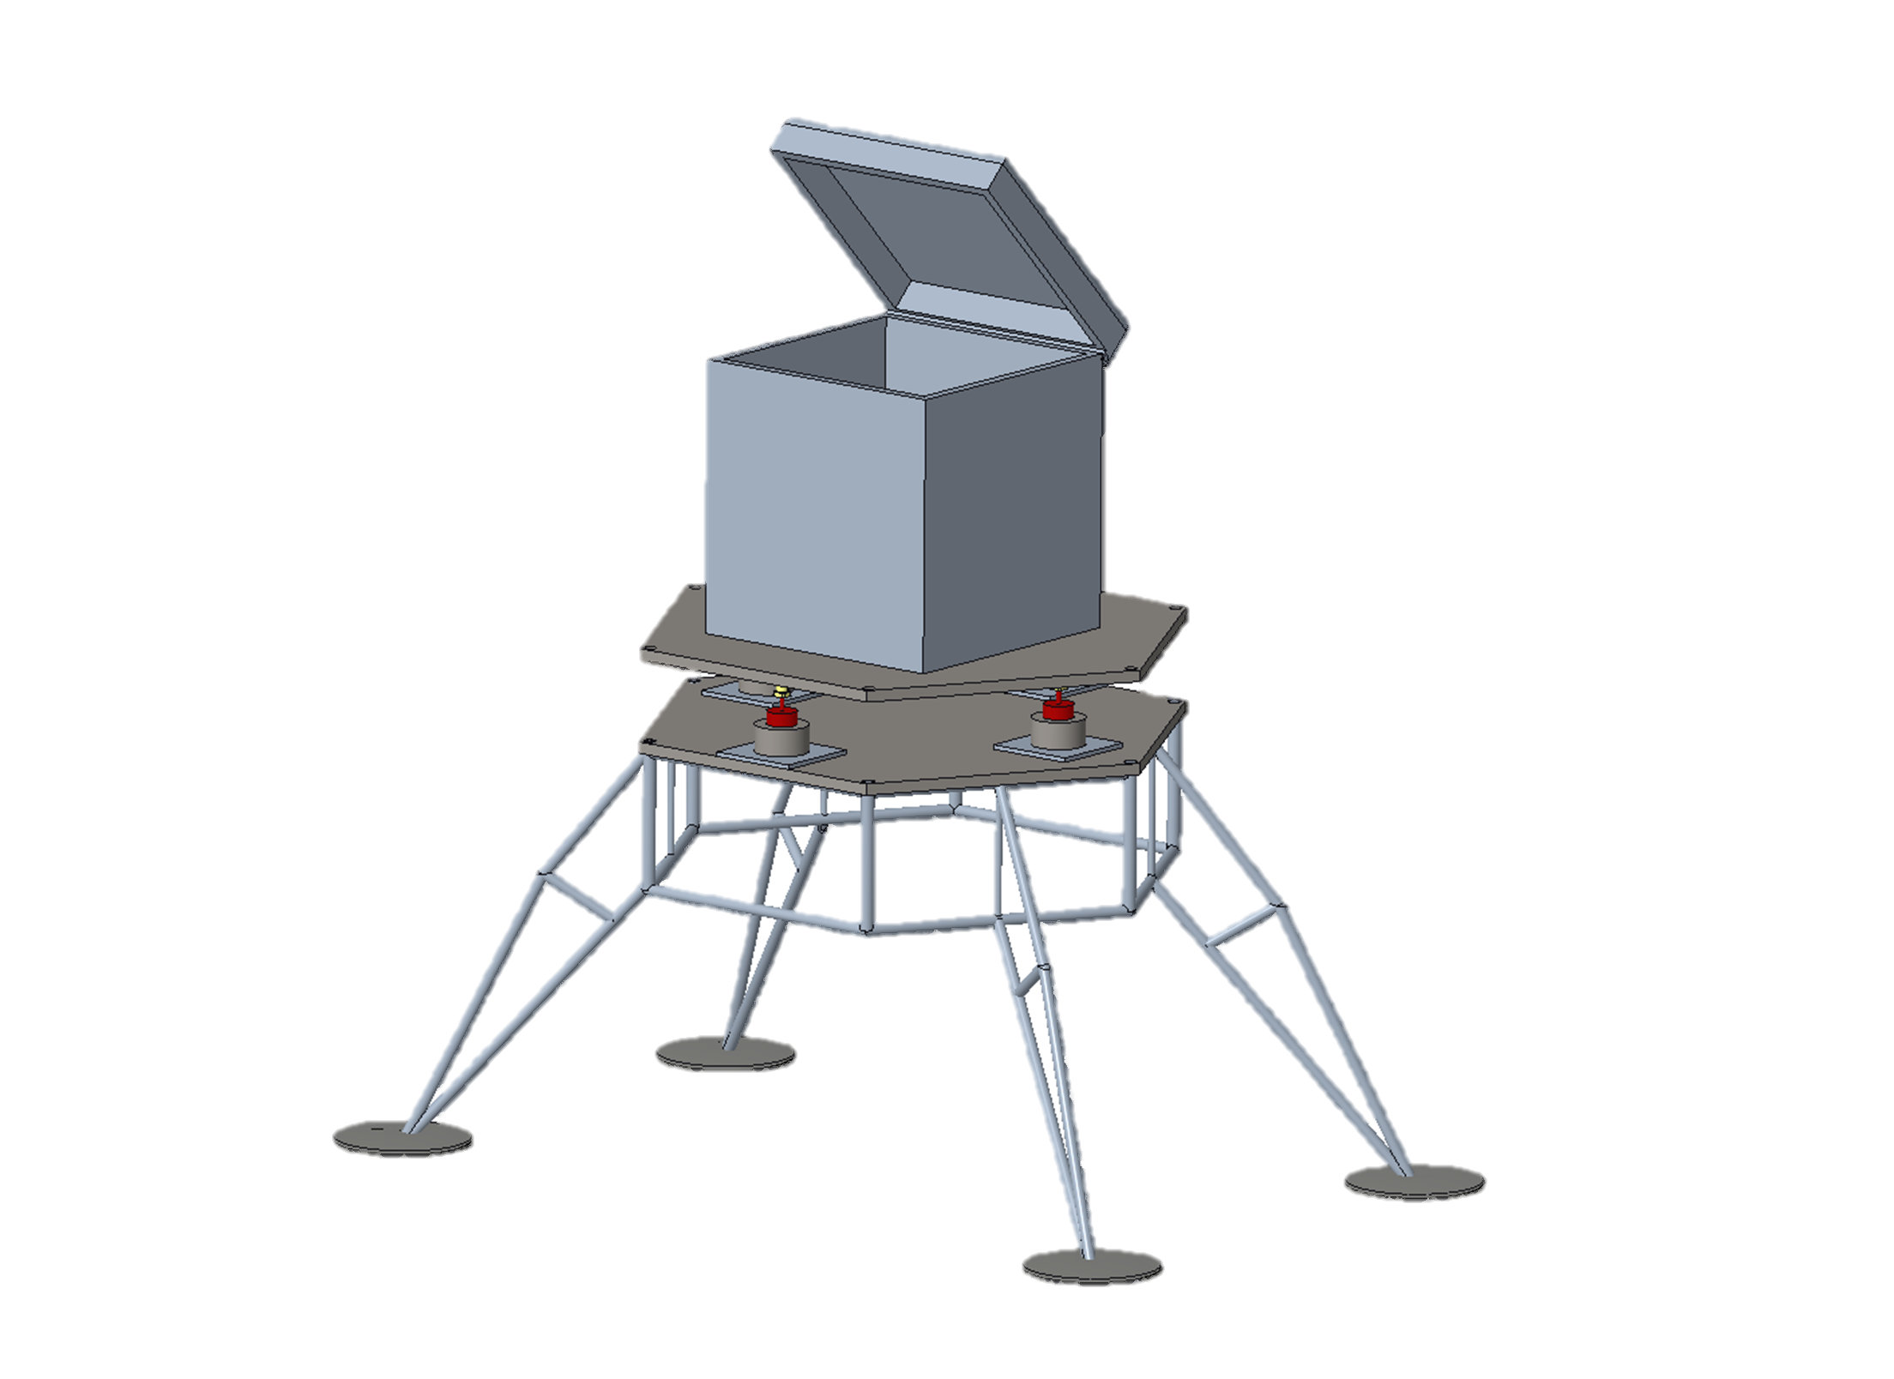
Assembled Prototype
Electronics Housing
Bottle Jack System
Prototype Base
Stephen Brown

Slide 14
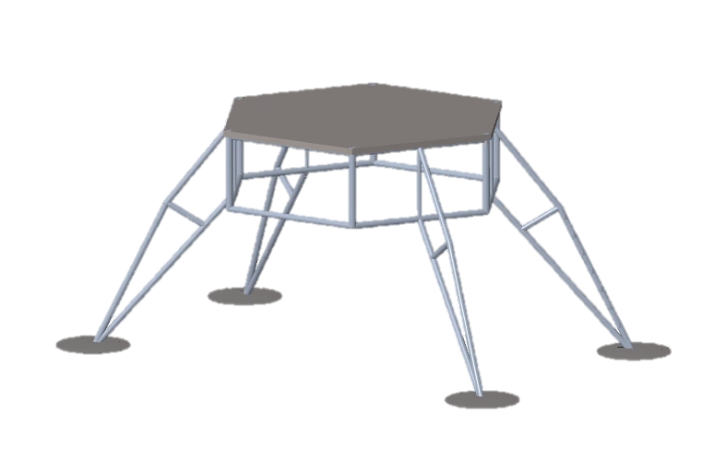
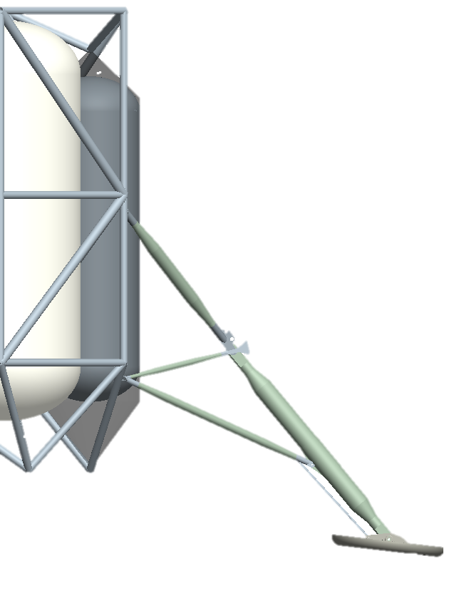
Prototype Base
Landing Gear Concepts designed by Spacecraft Design Team
Support up to 40lbs
Provide stable platform for equipment
Jake Seaman

Slide 15
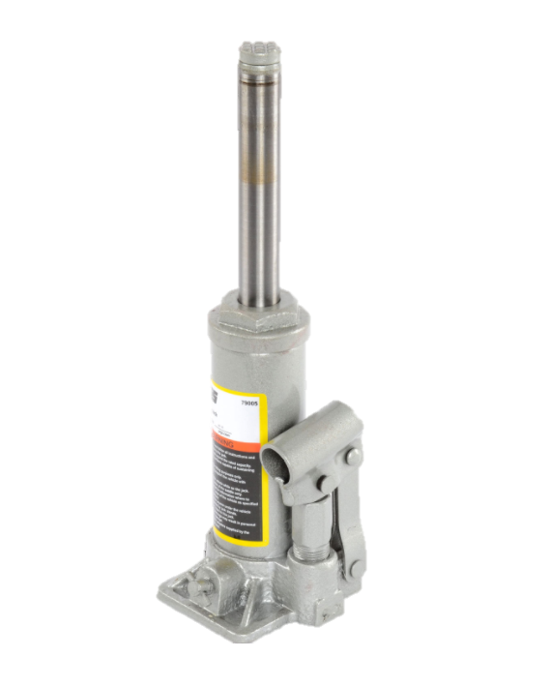
Bottle Jack System
Four bottle jacks placed symmetrically on the base plate
Fully extended upon landing
  Each jack will release pressure as needed
Ball Joint to allow higher degree of freedom at connecting point on the top
Jake Seaman

Slide 16
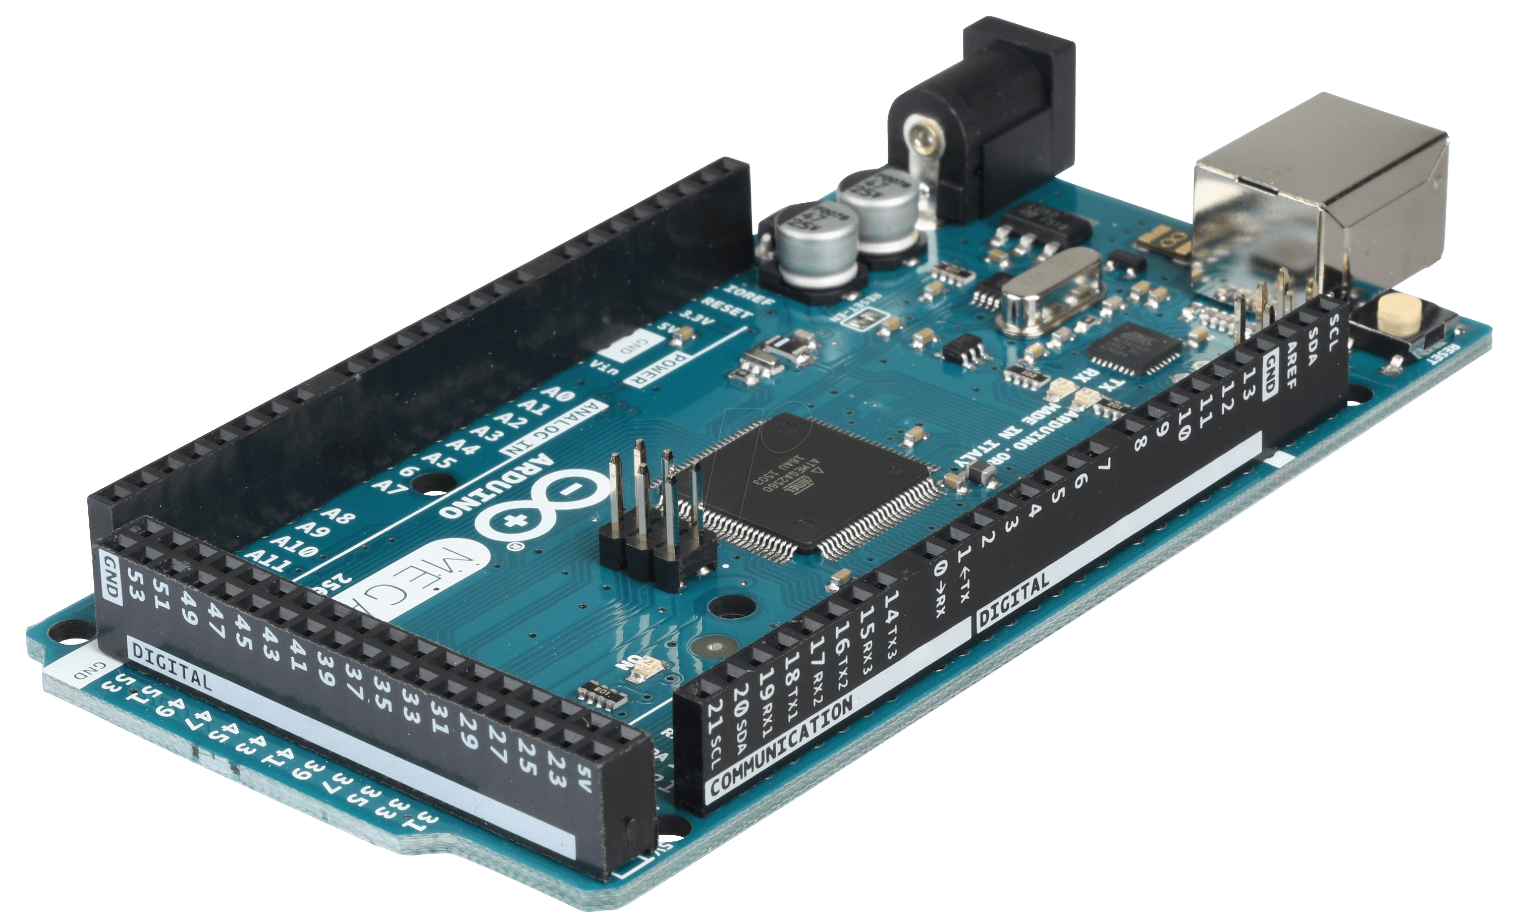
System Logic
Using Arduino Mega 2560
  Communicates initial orientation data via I2C (Inter-integrated Circuit Protocol)
  Iterative adjustments comparing current angle to pre-adjust angle
  Coarse adjustment until within ±5° of level, fine adjustment until ±2°
Jake Seaman

Slide 17
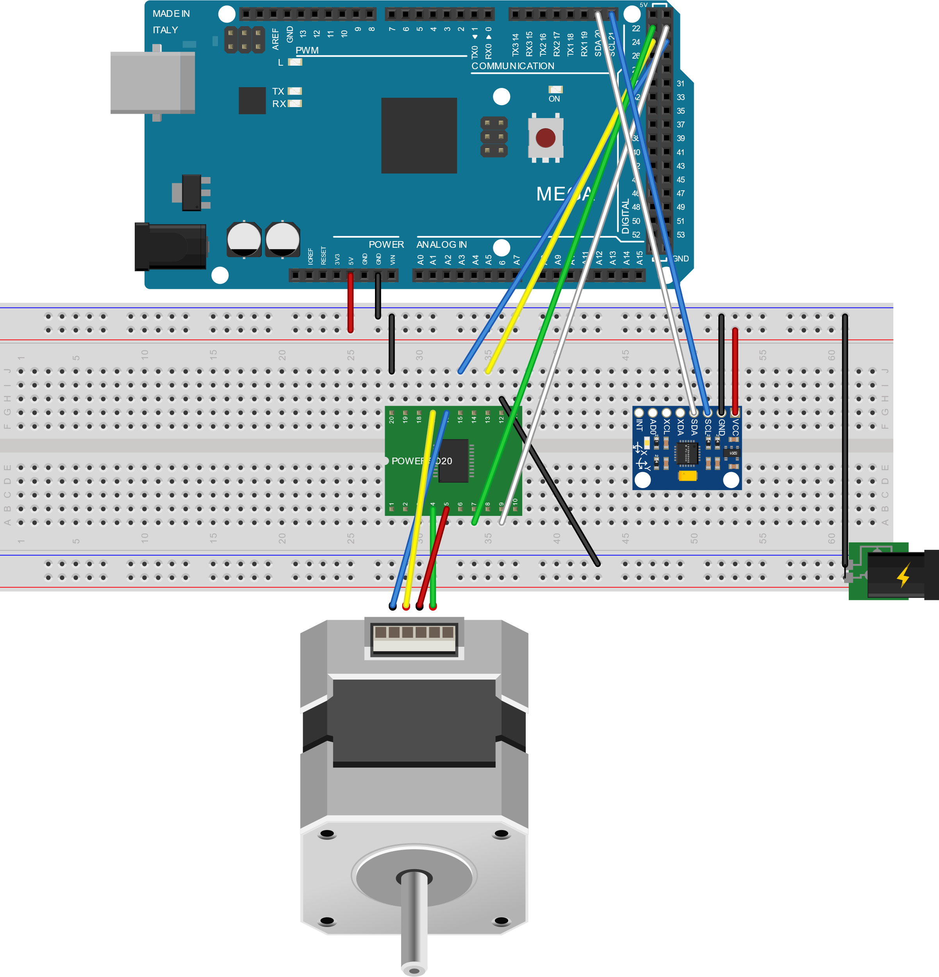

Wiring Schematic
Arduino Mega 2560
L298 Motor Driver
GY-521 IMU
12V 35Ah
NEMA17 Stepper
Jake Seaman

Slide 18
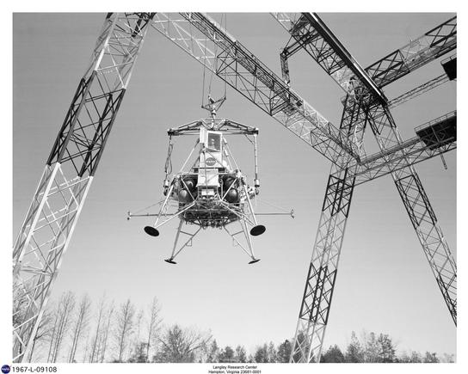
Testing
Will be using simulations to test design in lunar-like conditions and impact force
Physical prototype to test leveling capabilities
Jake Seaman

Slide 19


Schedule
In Progress
Not Started
Identified Risk
Current Stage
Jake Seaman

Slide 20
Design Expectations
Complications and risks
Confirm power needed for prototype
Reduce unnecessary weight
Fine tuning of leveling accuracy and speed
Final presentation at Marshal Space Flight Center
Jake Seaman

Slide 21







NASA Self-Leveling System
EML 4551
Team 516:
Stephen Brown
James Evans
Dalton LeClair
Jake Seaman
Parker Stensrud

Slide 22
Reference
Apollo-Animation [.mpg]. (2020, October 08). NASA.
Reichelt elektronik GmbH & Co. KG Internet Team (webmaster@reichelt.de). (n.d.). ARDUINO MEGA - Arduino Mega 2560, ATmega1280, USB. Retrieved January 11, 2021, from https://www.reichelt.com/de/en/arduino-mega-2560-atmega1280-usb-arduino-mega-p119696.html?GROUPID=6667&&r=1
S. (n.d.). Landing Gear Concepts & Metrics Review. NASA PowerPoint.
Fuchs, Y. (2007, June 28). Lunar Lander Landing System Dynamics Analysis, Testing, and Certification. NASA PowerPoint.
JEGS 79005: Bottle Jack 2-Ton Capacity: JEGS. (n.d.). Retrieved January 13, 2021, from https://www.jegs.com/i/JEGS+Performance+Products/555/79005/10002/-1
NASA’s Lunar Exploration Program Overview. (2020, September). Retrieved January 10, 2021, from https://www.nasa.gov/sites/default/files/atoms/files/artemis_plan-20200921.pdf

Slide 23
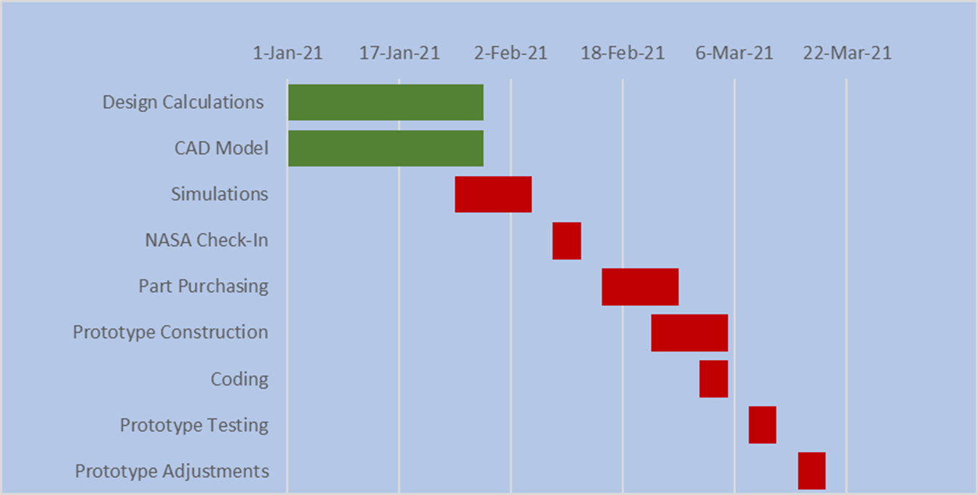


Future Work
Dalton LeClair

Slide 24
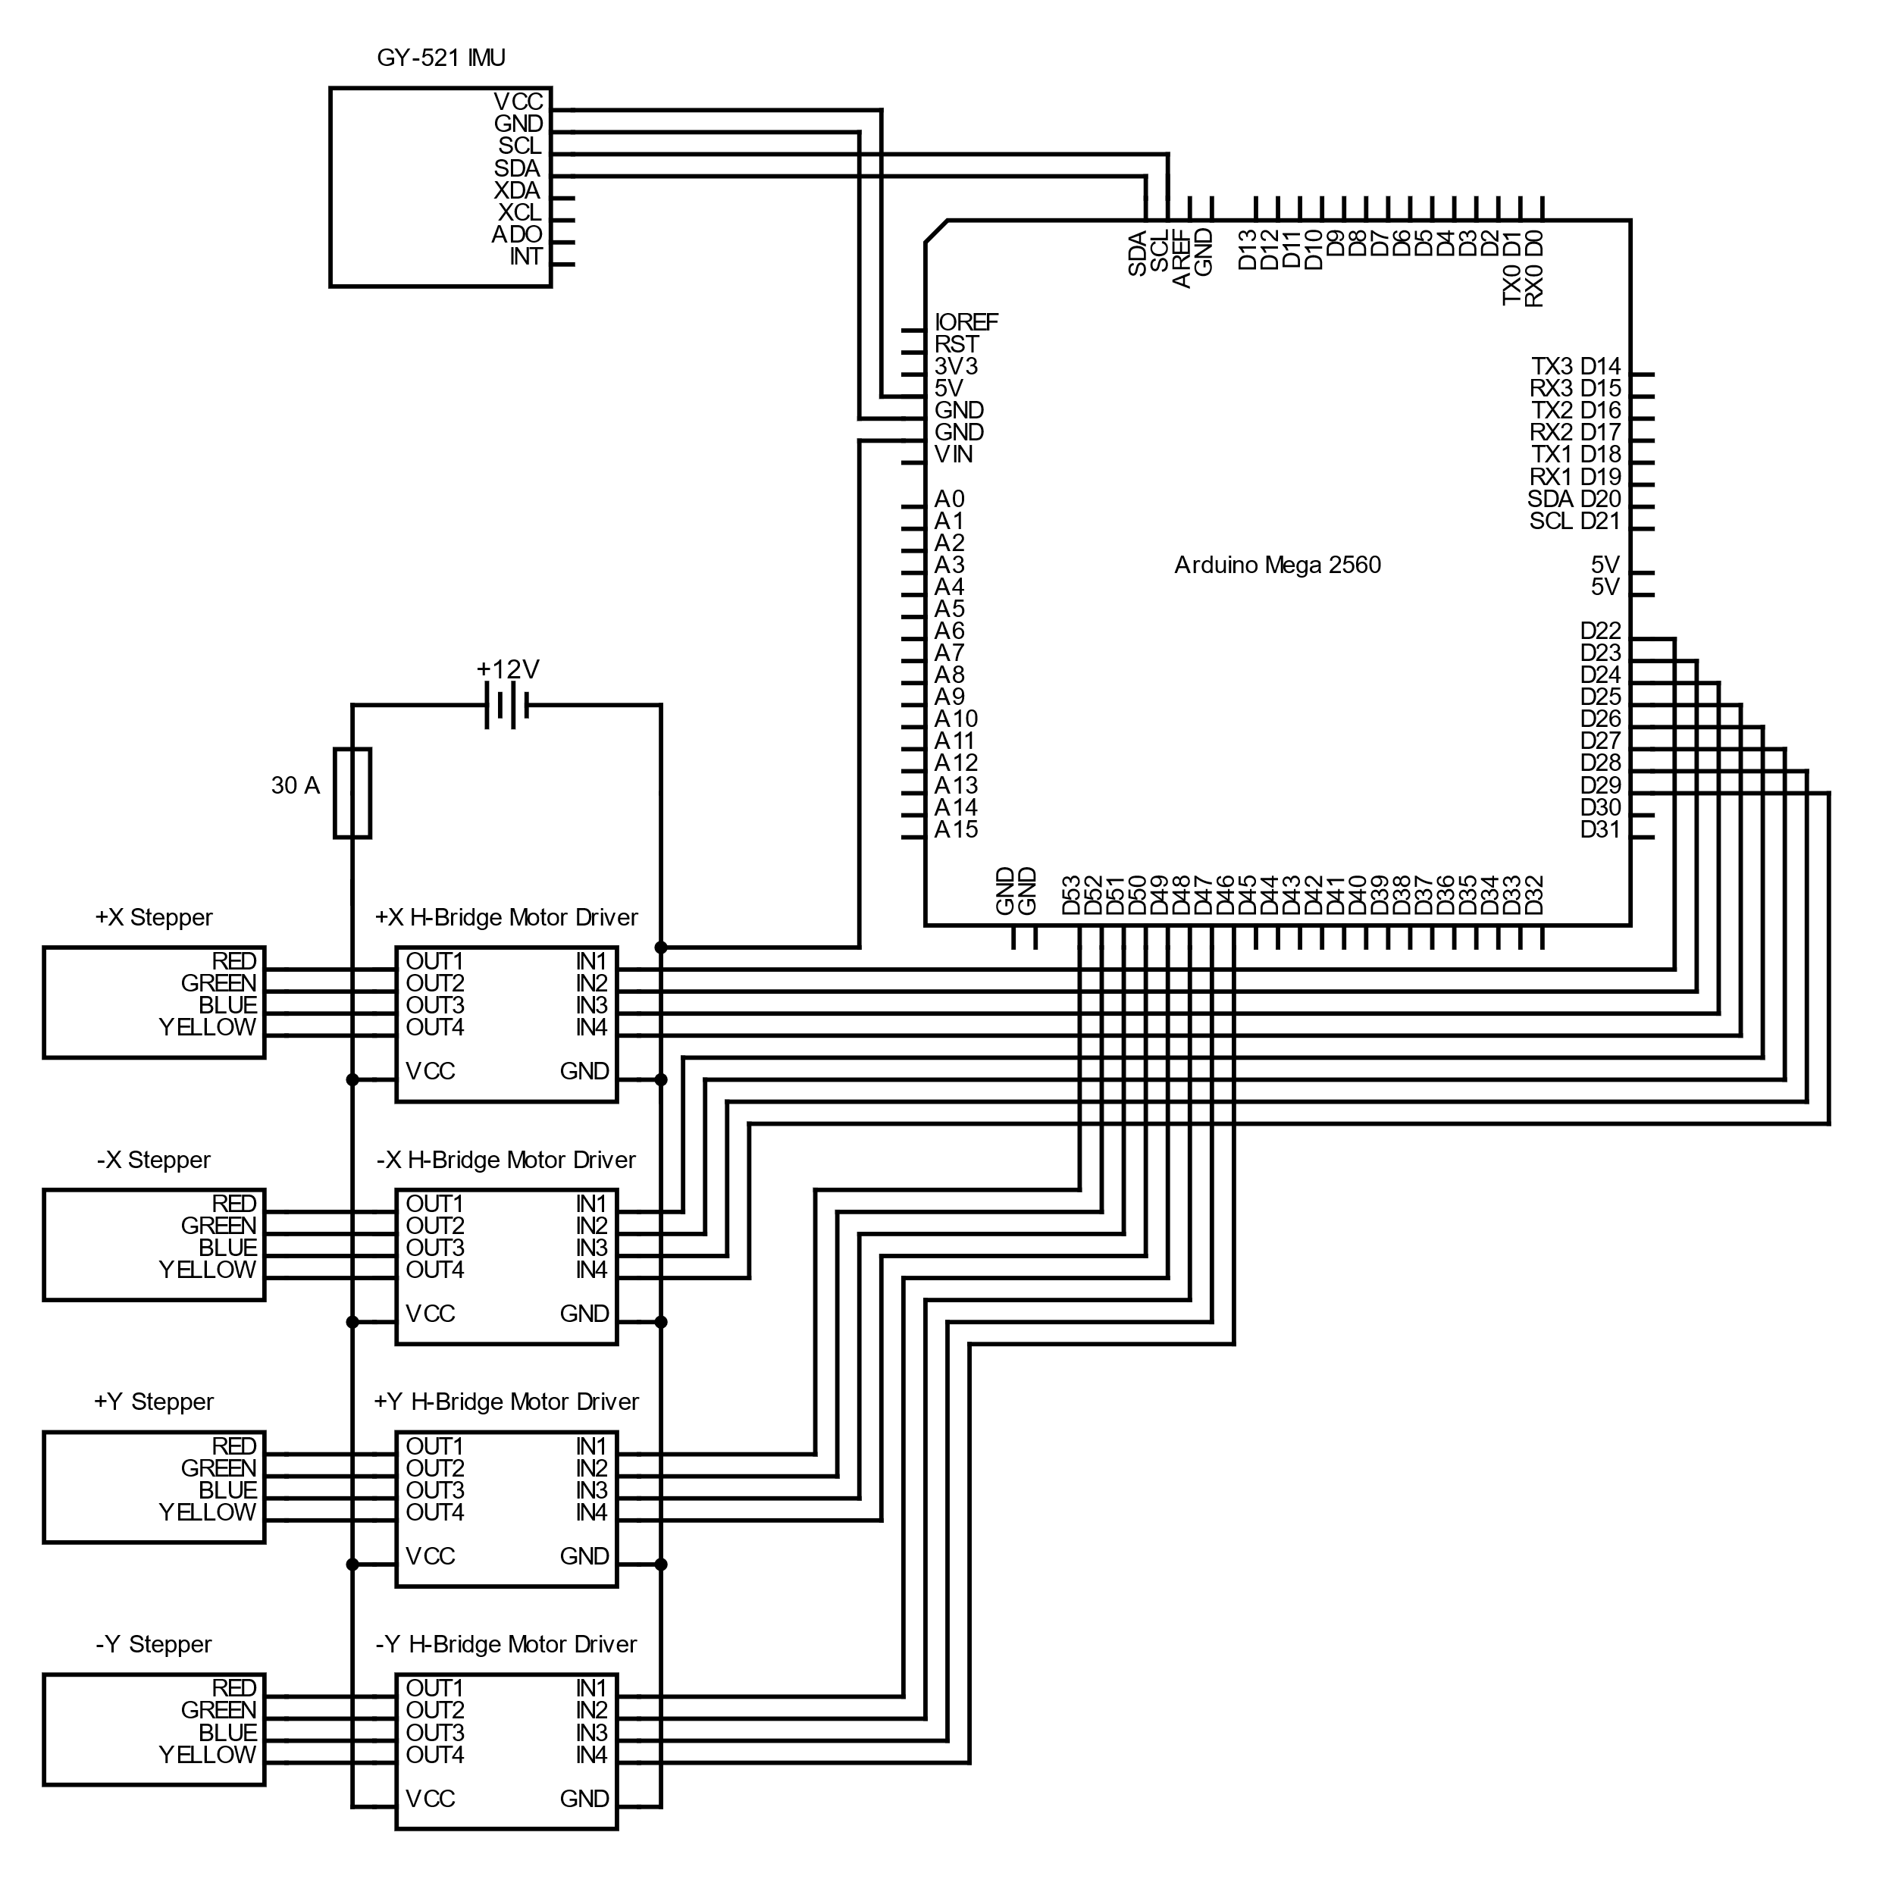

Slide 25
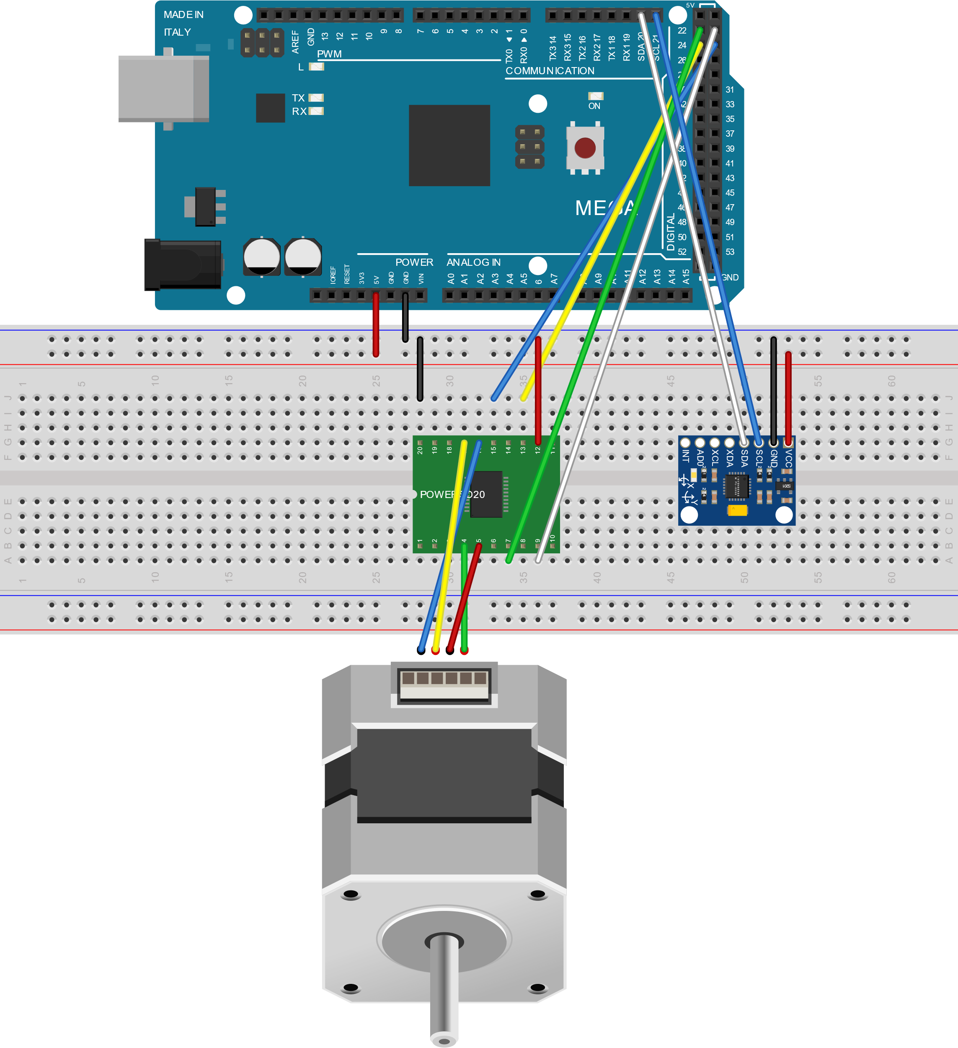
Wiring Schematic
Controlled by Arduino Mega 2560
  4 L298 Motor Drivers
  4 NEMA17 Steppers
  GY-521 IMU for input
  12V 35Ah battery in parallel used to power the steppers
Dalton LeClair

Slide 26

Environmental Challenges
Sand-blasting due to regolith
Coefficient of thermal expansion
Cold Welding
Radiation
Dalton LeClair

Slide 27
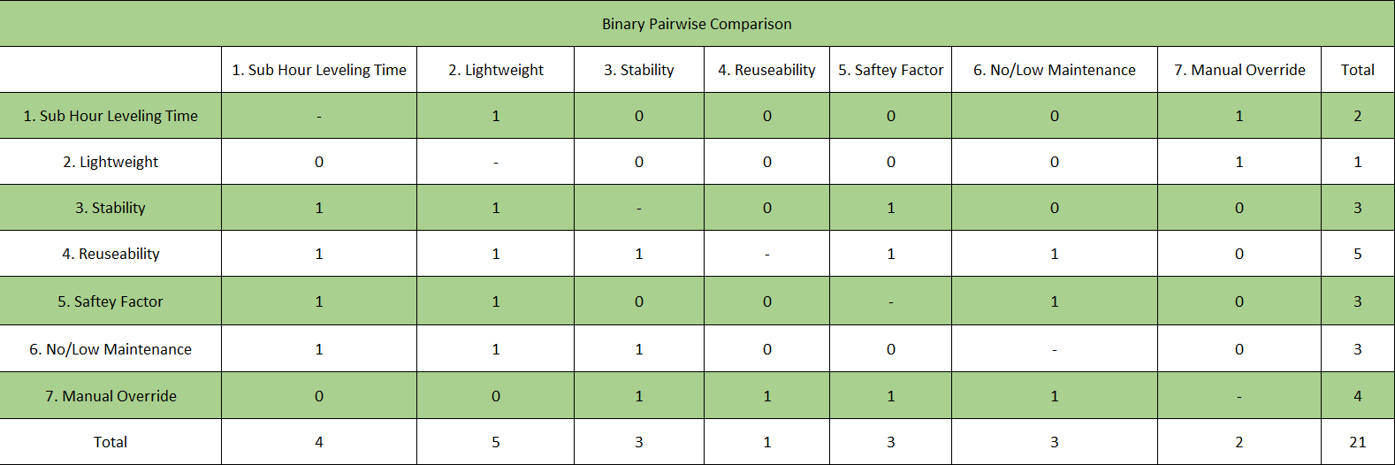
Binary Pairwise Comparison
Parker Stensrud
Notes:
customer requirements on both axis.

Slide 28
Binary Pairwise Comparison
Parker Stensrud
Notes:
These are customer requirements . Used to get importance weight factor

Slide 29
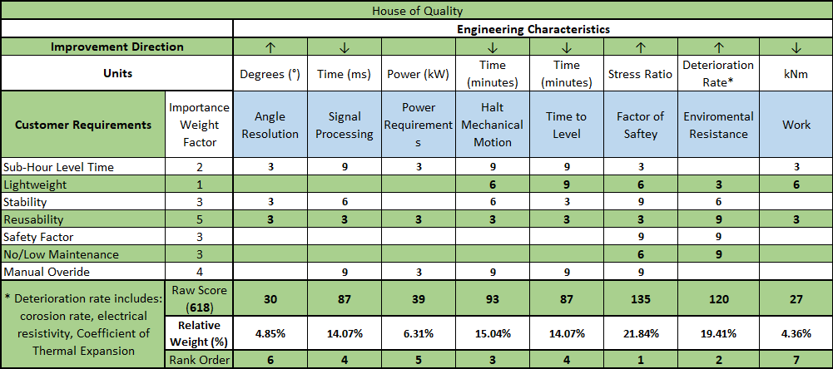
House of Quality
Parker Stensrud

Slide 30
House of Quality
Parker Stensrud

Slide 31
House of Quality
Parker Stensrud
Notes:
engineering characteristics are derived from the functional decomposition

Slide 32
House of Quality
Parker Stensrud

Slide 33
Concepts
Datum(slider)
Rack and pinion
Secondary landing gear
Bottle Jack
Gas System
Telescopic legs
Spring System
Tripod
James Evans

Slide 34
Concepts
Datum(Tripod)
Spring System
Rack and pinion
Bottle Jack
Gas System
James Evans

Slide 35
Final Three Concepts
Spring System
Bottle Jack
Gas System
James Evans

Slide 36
Analytical Hierarchy Process
James Evans
19

Slide 37

Leveling Functions
Sense
Power
Lander
Motion
Dalton LeClair

Slide 38
Concept Generation
Dalton LeClair
Notes:
Remember to say that all the concepts get information from the onboard IMU during the presentation

Slide 39

Medium Fidelity
Three-Legged Tripod
  Whole leg design
  Integrated into the landing gear
Slider System
XY translation of the lander cabin to move the center of mass until level
Second Landing Gear
Compact until deployed
Multiple arms to lift the lander until level
Gas Release
Piston Cylinder Assembly
Compressed gas in cylinder is released to level
Rack and Pinion
Allow to move upward and downward
Can be fine-tuned
Dalton LeClair

Slide 40
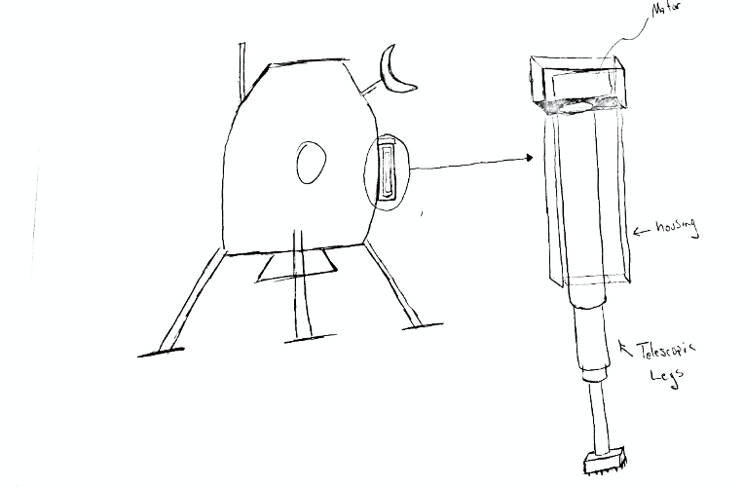
High Fidelity
Telescopic Legs
  Secondary legs not used for landing
  Four (4) housings containing retracted legs and motor to extend them
  Housing will have brush like bottom to dust off legs upon retraction
Parker Stensrud

Slide 41
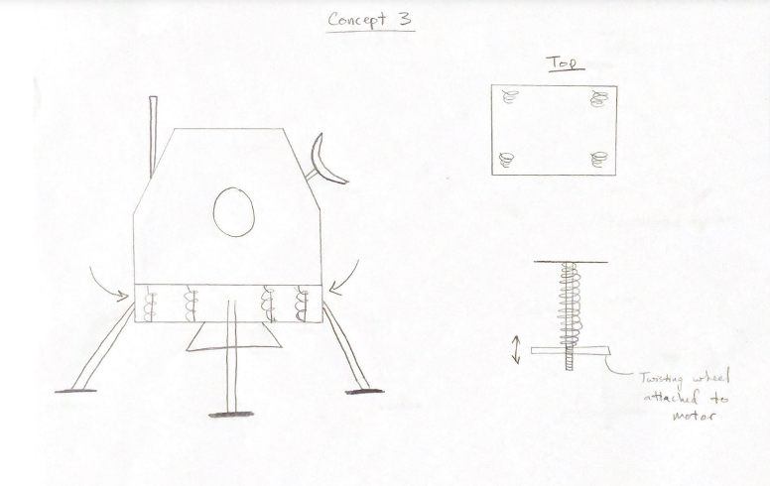
High Fidelity
Spring System
  Begin fully extended
  Springs will be tightened via motors and lowered until level (operates like 3D printer bed)
  Mechanism will be isolated from the elements
Parker Stensrud

Slide 42
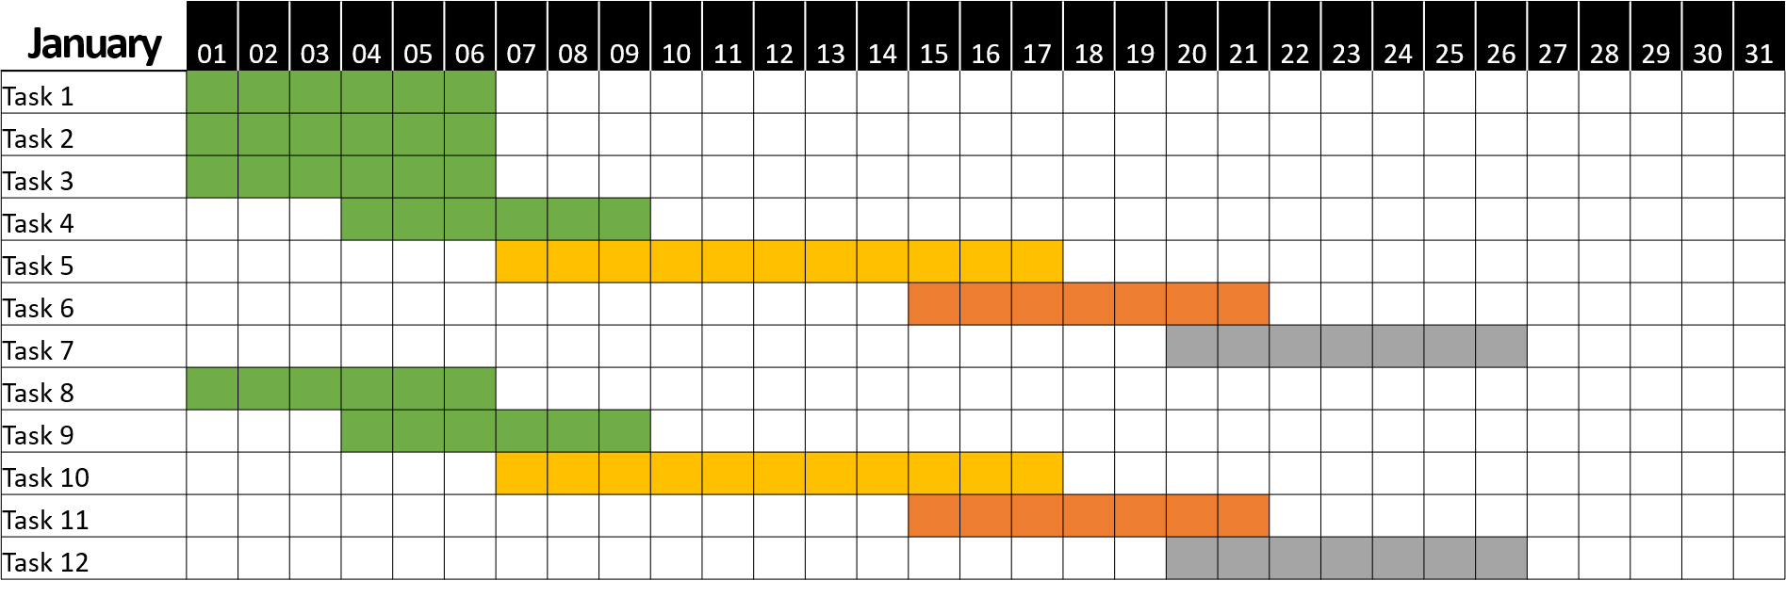
Future Work
January Daily Chart
Milestone 1
Milestone 2
⬧
X Days
⬧
Complete
Identified Risk
Summary: The quick brown fox jumps over the lazy dog. The quick brown fox jumps over the lazy dog. The quick brown fox jumps over the lazy dog. The quick brown fox jumps over the lazy dog. The quick brown fox jumps over the lazy dog.
In Progress
Not Started

